Slide 1

MySQL Installation Guide

Slide 2
Contents
What is MySQL
Why MySQL
What is MySQL workbench
MySQL Installation
Downloading
Installing
Working

Slide 3
MySQL

Slide 4
What is MySQL?
Oracle powers MySQL Workbench, a cross-platform application.
An open-source database management system that is quick, dependable, and extremely scalable.
Why MySQL?
It is an open-source software, You don't have to pay a dime to use its services.
Cross-Platform software that may be used with Windows, Linux, Unix, and other operating systems.
High availability features a powerful processing architecture.
Reliability provided by secure connections for MySQL are provided through SSH and SSL.
Features like data encryption and data backup for recovery are included with MySQL.

Slide 5
What is MySQL?
Oracle powers MySQL Workbench, a cross-platform application.
An open-source database management system that is quick, dependable, and extremely scalable.
Why MySQL?
Various Storage Engines
Superior Performance
Cost-Effective
Cross-Platform

Slide 6
What is MySQL Workbench?
A unified piece of software called MySQL Workbench is used to simplify and enhance SQL development tasks.
Data modelling, SQL creation, and other management tools are all provided by MySQL Workbench for configuration.
Additionally, it provides a graphical user interface for organized database interaction.

Slide 7

Installing MySQL

Slide 8
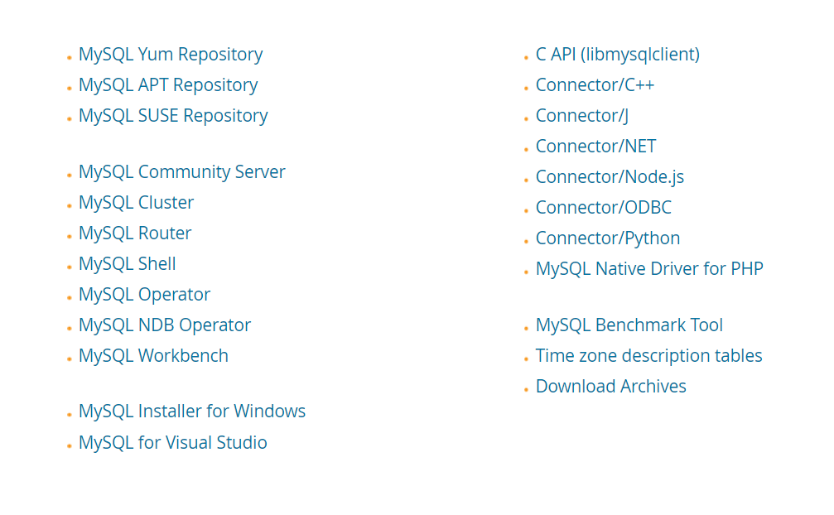
MySQL download
CTRL + Click on the above link
Select the appropriate link

Slide 9
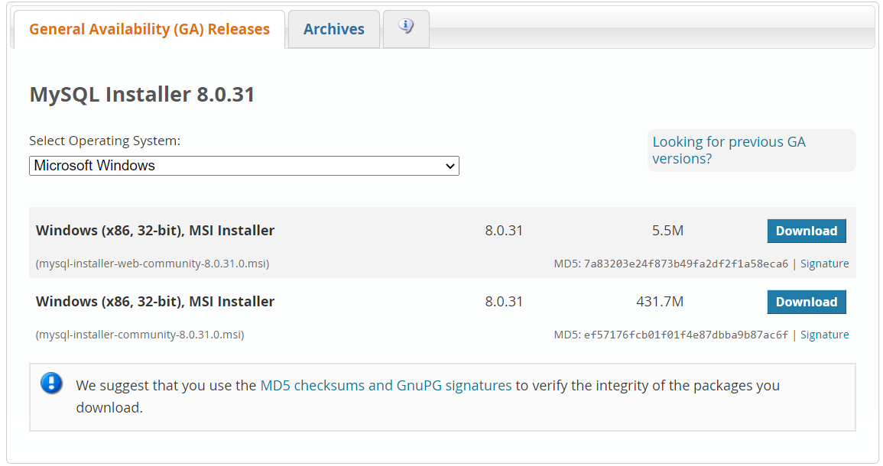
On selecting the link (here MySQL Installer for Windows) we navigate to the next screen as shown.
Then click on the download button according to the desired installer.

Slide 10
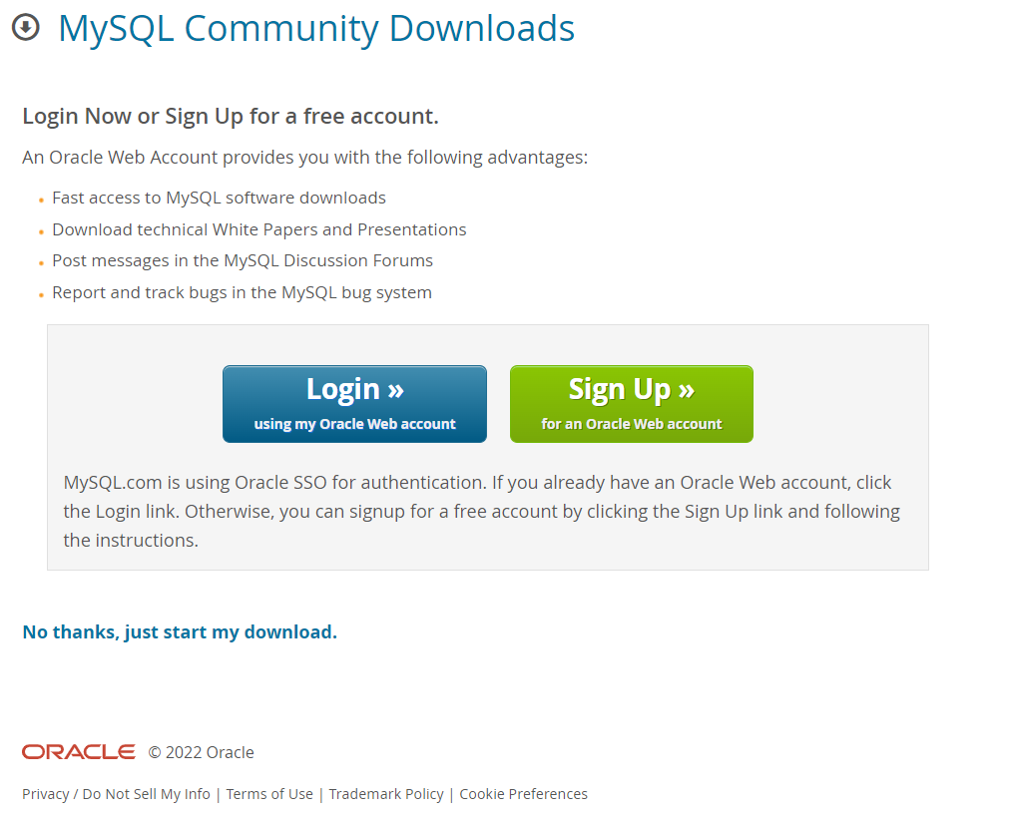
On this next page that appears just go the option of “No thanks, just start my download”.
The download starts automatically.

Slide 11
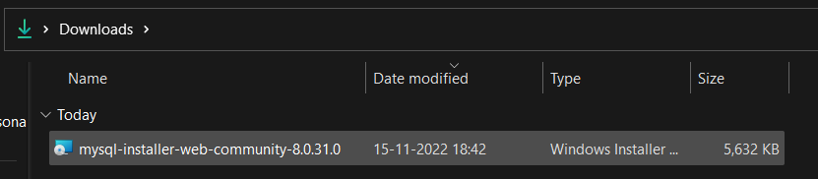
Go to the folder where the installer has been downloaded
Run the installer by double clicking on it.

Slide 12
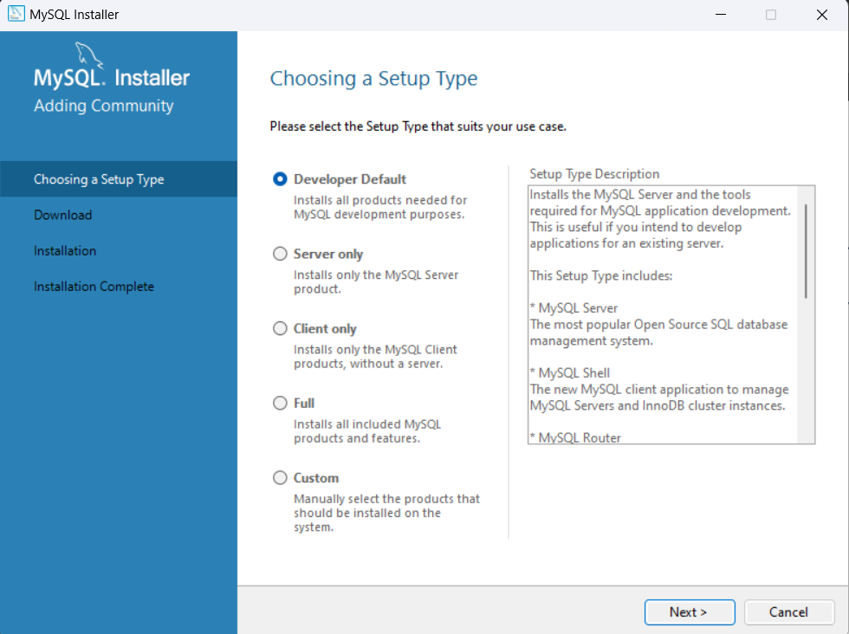
After running the installer you get a new window like this.
Select custom and click Next.

Slide 13
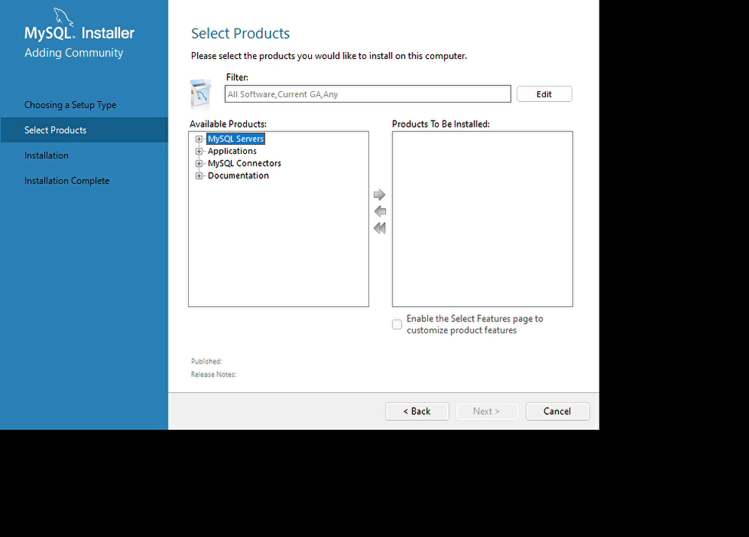
After running the installer you get a new window like this.
Select custom and click Next
On the next window, My SQL Servers -> MySQL Server -> My SQL Server 8.0 -> MySQL Server 8.0.31 – x64
On the next window, My SQL Workbench -> MySQL Workbench -> My SQL Workbench 8.0 -> MySQL Workbench 8.0.31 – x64
On the next window, My SQL Shell -> MySQL Shell -> My SQL Shell 8.0 -> MySQL Shell 8.0.31 – x64
Select the version according to your computer specifications.

Slide 14
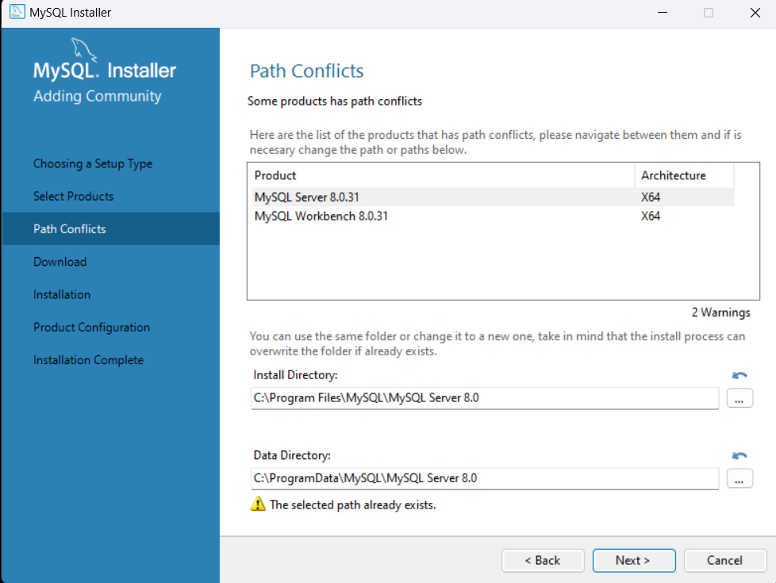
In the next window , we can see the path to which the MySQL will be installed.
You can change the path if needed else leave it default (recommended).
Click on Next.

Slide 15
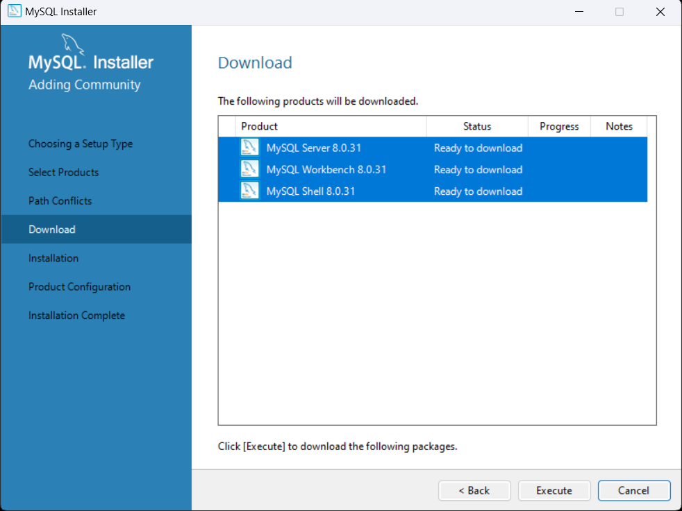
Here, we can see the packages we selected are ready for download.
Click on execute.
It will take a while for the download to complete once downloaded then click on Next.

Slide 16
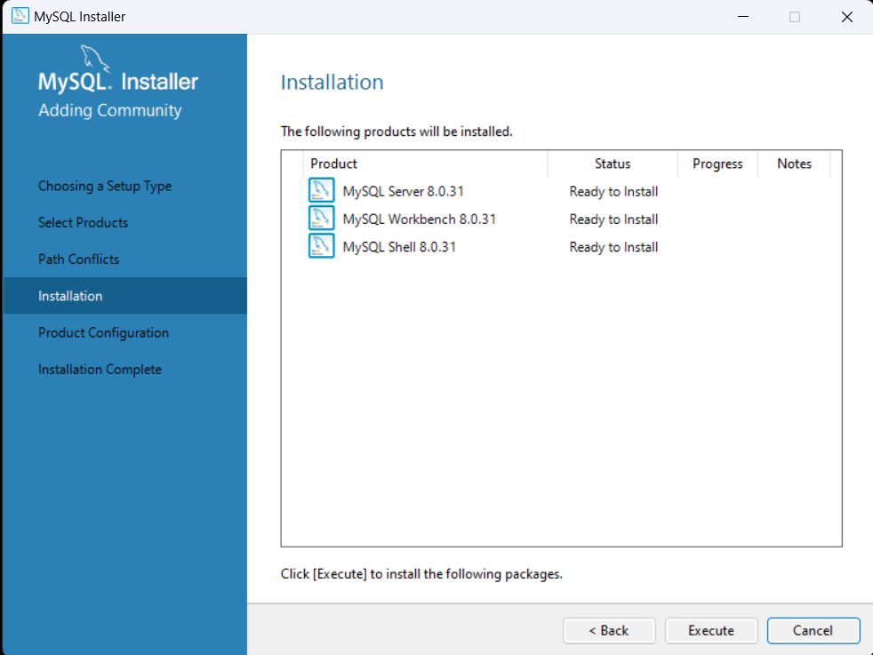
After downloading the packages are now ready to install.
Click on execute.
Once all the packages are installed click on Next.

Slide 17
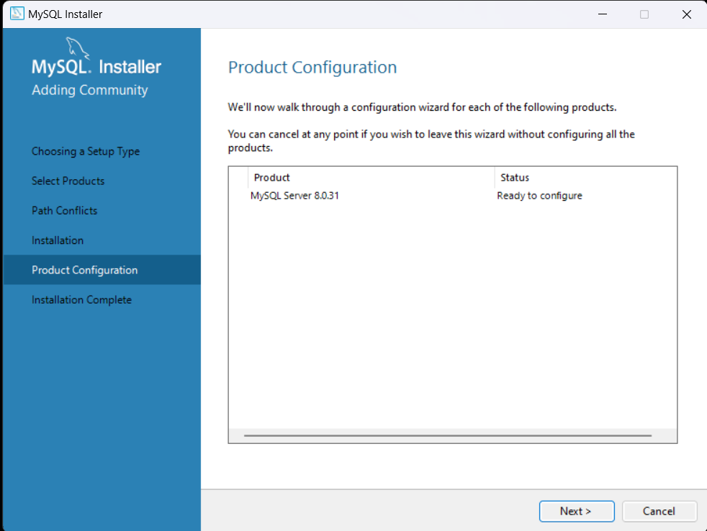
Once the packages are installed, the next step is the product configuration.
Click on Next.

Slide 18
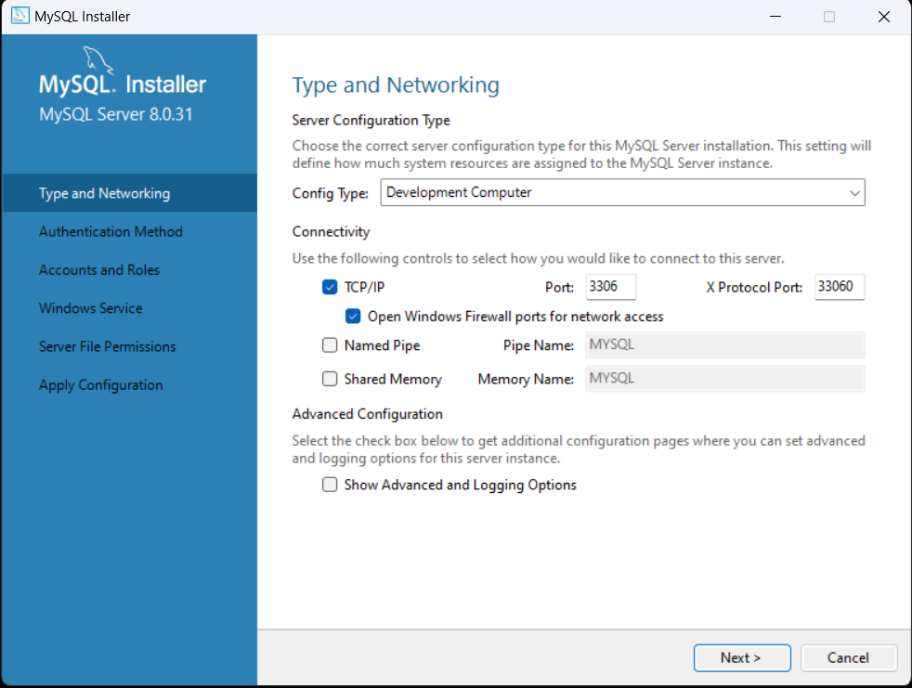
Initially the sever configuration appears leave it default.
It is the port through which we connect to the MySQL Workbench.
Click on Next.

Slide 19
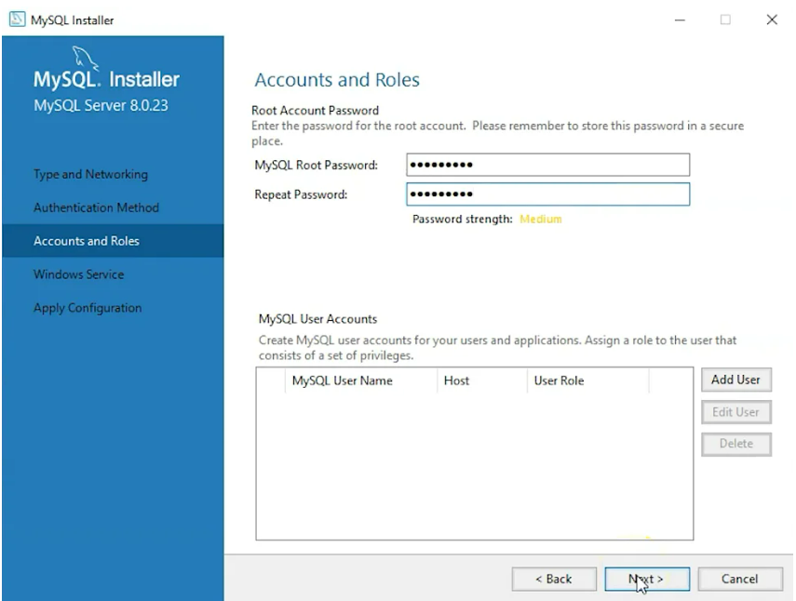
The next window we have to setup the password.
Enter the password and click on Next.

Slide 20
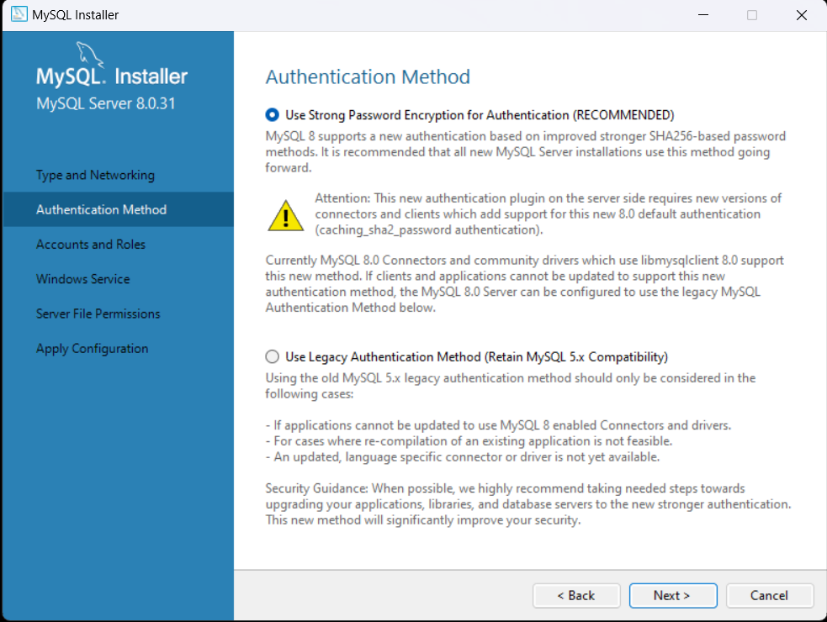
After setting up the password, for the authentication method chose the recommended option and click Next.

Slide 21
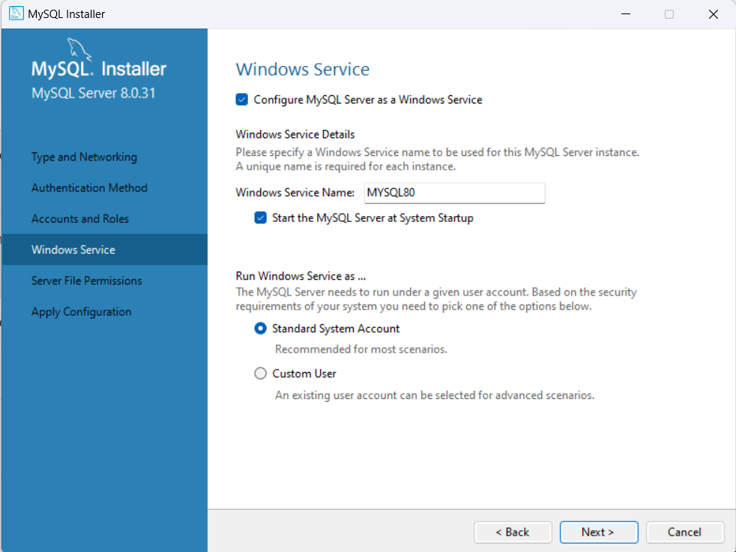
In window service in next step leave the selections default and click on Next.

Slide 22
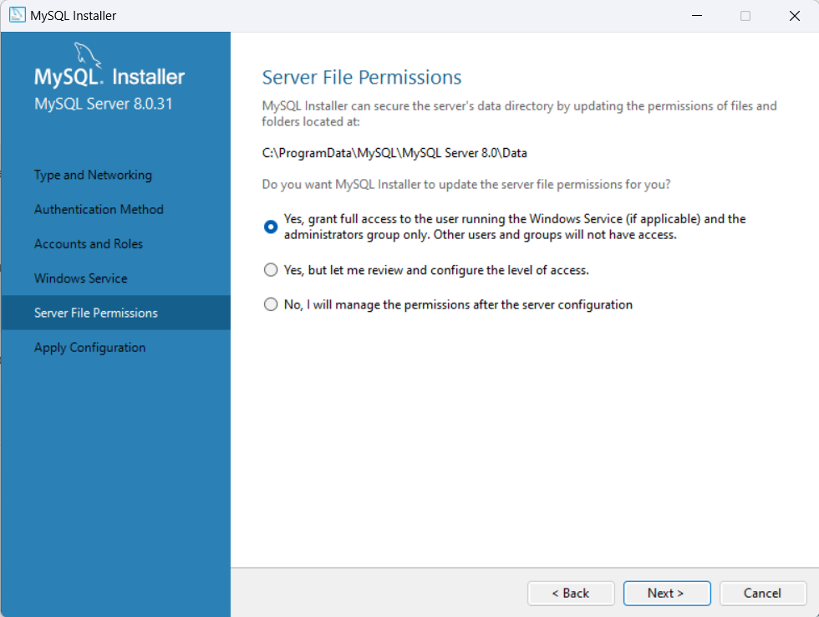
In next window for server file permission you choose the option as per your wish.
Go to Next

Slide 23
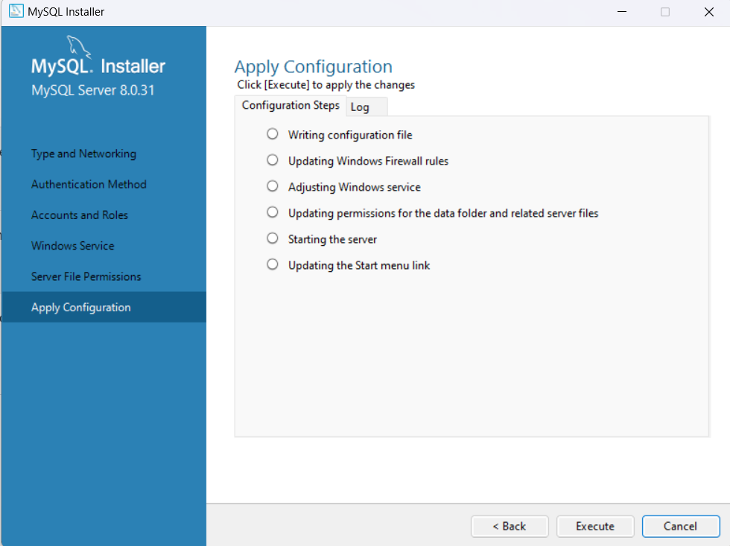
Finally, we have set all the settings for the product configuration and they are ready to execute.
Once the execution is done, we are done with configuration click on Finish.

Slide 24
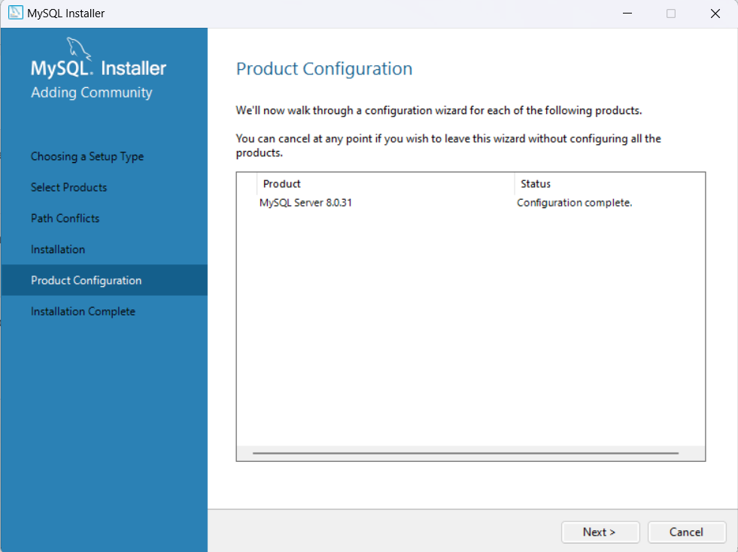
The product configuration window appears again just click on Next.

Slide 25
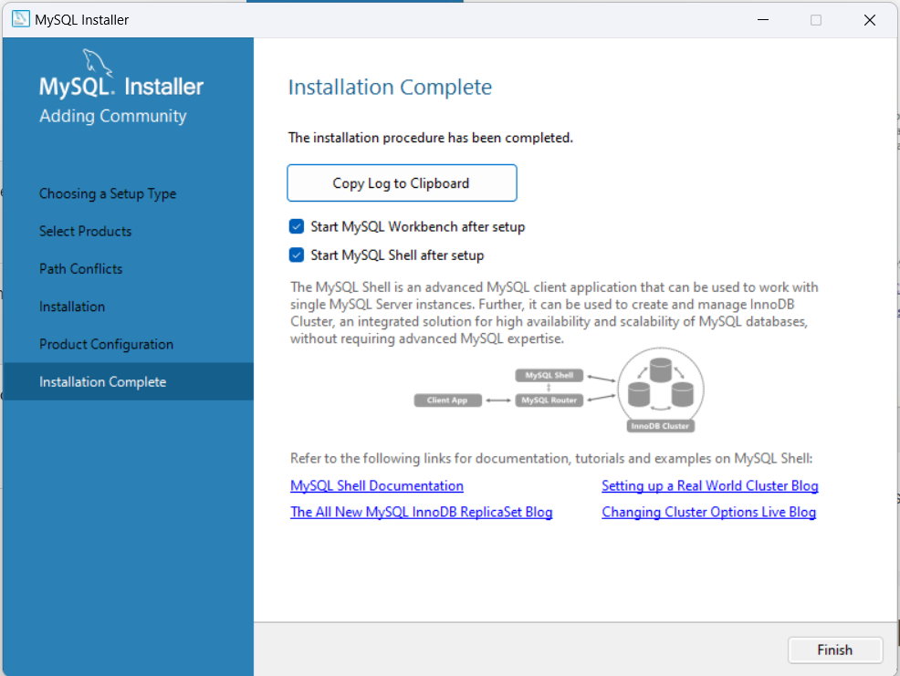
The last step installation click on Finish and we are done with installation process.

Slide 26
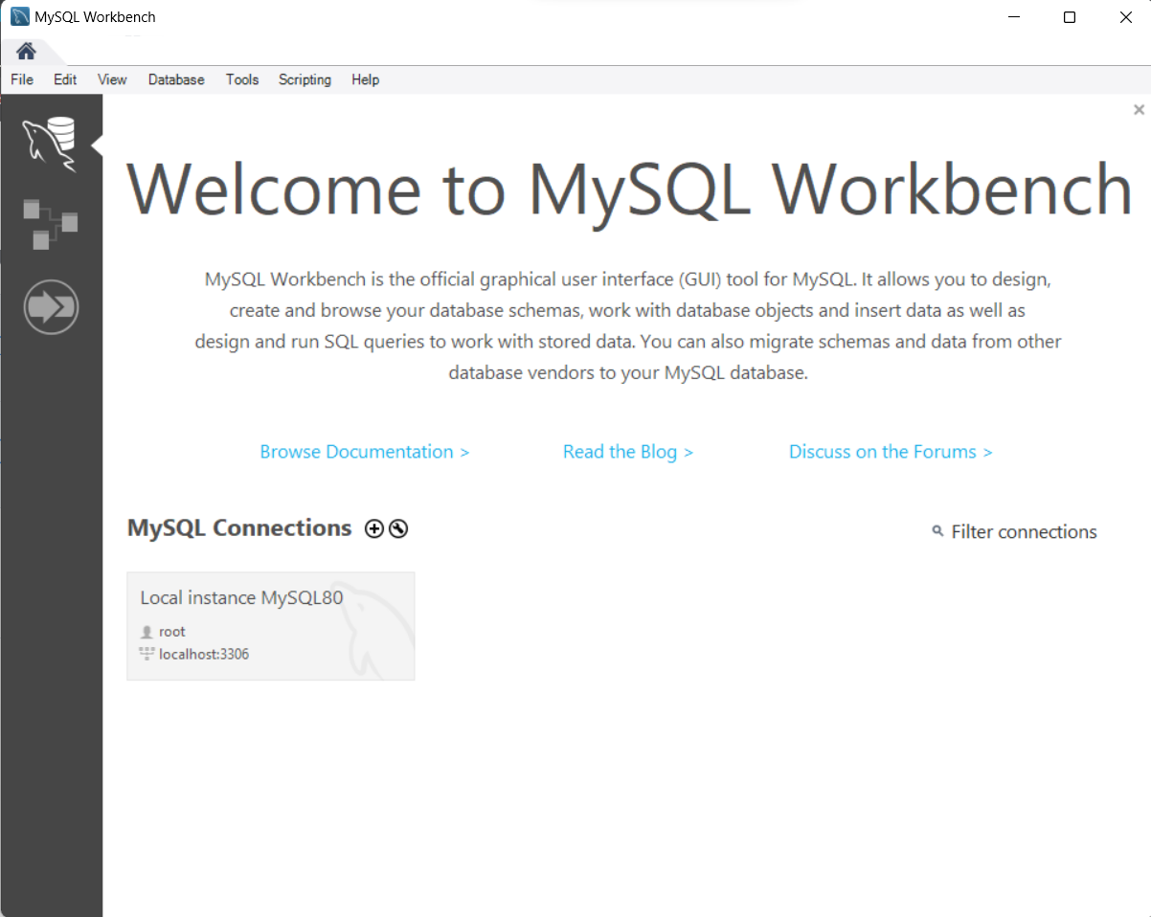
On finish the MySQL workbench opens up and the window is as shown in figure.
Click on the local instance MySQL80 icon to start the workbench.

Slide 27
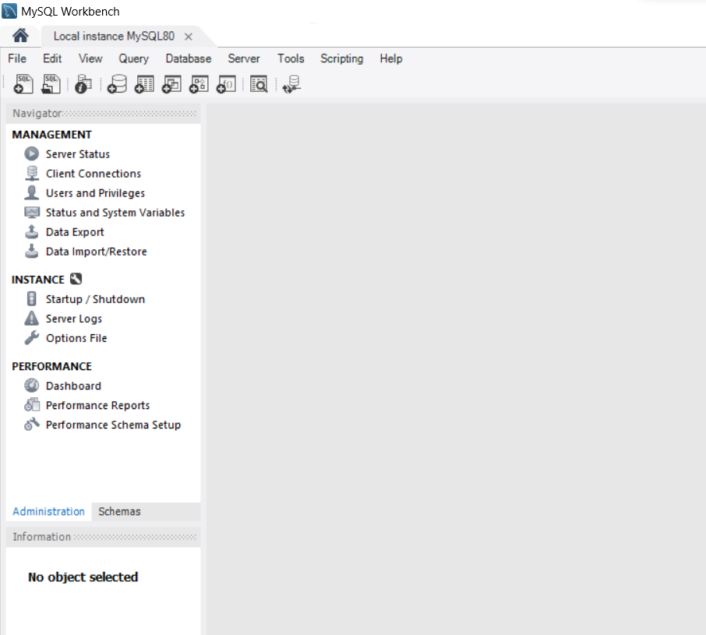
On selecting the local instance the workspace opens up.

Slide 28
Thank You !

